Slide 1
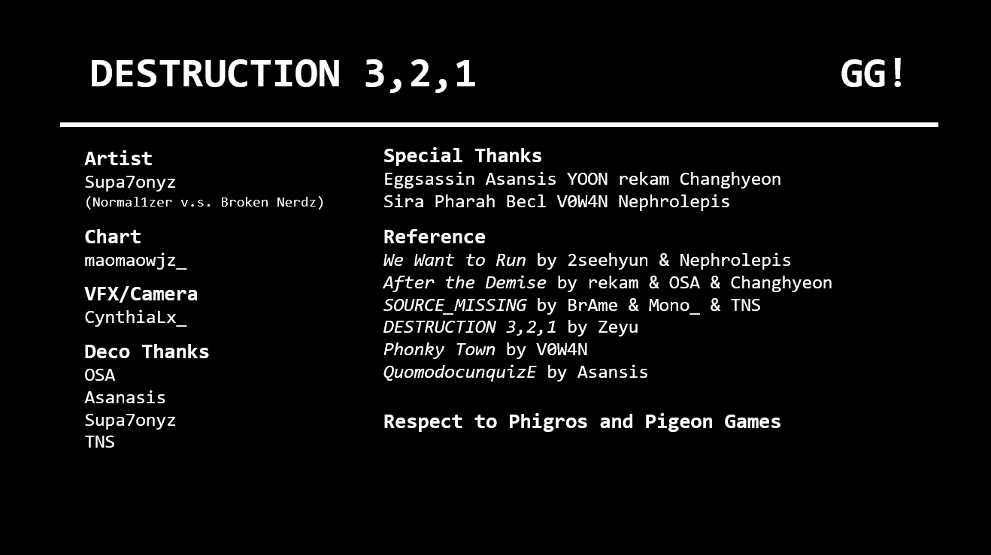
DESTRUCTION 3,2,1 GG!
Artist
Supa7onyz
(Normal1zer v.s. Broken Nerdz)
Special Thanks
Eggsassin Asansis YOON rekam Changhyeon
Sira Pharah Becl V0W4N Nephrolepis
Chart
maomaowjz_
Reference
We Want to Run by 2seehyun & Nephrolepis
After the Demise by rekam & OSA & Changhyeon
SOURCE_MISSING by BrAme & Mono_ & TNS
DESTRUCTION 3,2,1 by Zeyu
Phonky Town by V0W4N
QuomodocunquizE by Asansis
VFX/Camera
CynthiaLx_
Deco Thanks
OSA
Asanasis
Supa7onyz
TNS
Respect to Phigros and Pigeon Games

